Slide 1
Model Analysis using CDC Diabetes
By Logan Nelson

Slide 2
Introduction
Purpose
Models Selected
Test models on a large dataset
Investigate new models (LVQ)
Analyze performance of newer models vs known models
Logistic Regression
SVM
Naïve Bayes
Decision Tree
Random Forest
Adaboost
Learning Vector Quantization (LVQ)

Slide 3
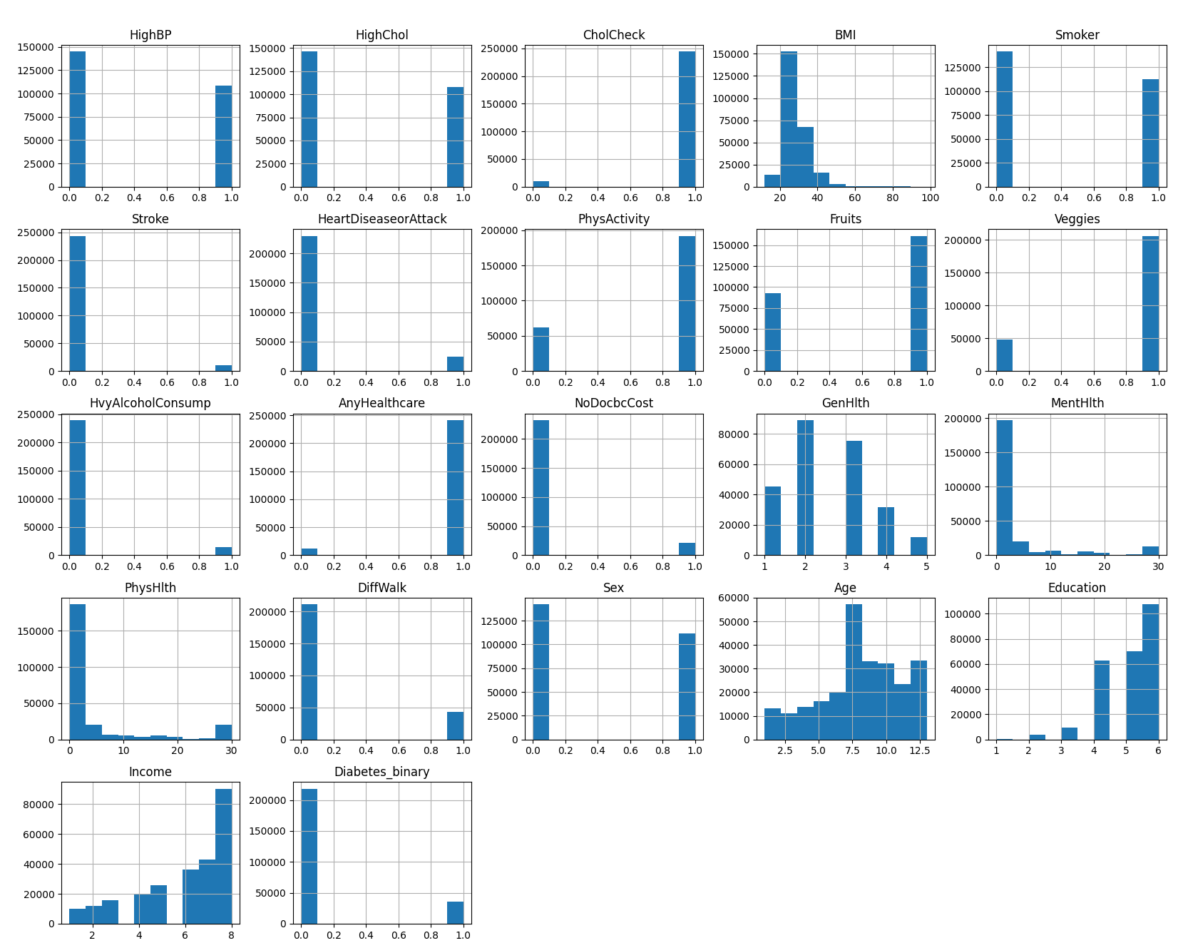
Feature Analysis
21 Features
14 binary features
7 numeric features
No NULL rows or missing values
No categorical values
253,680 Rows

Slide 4
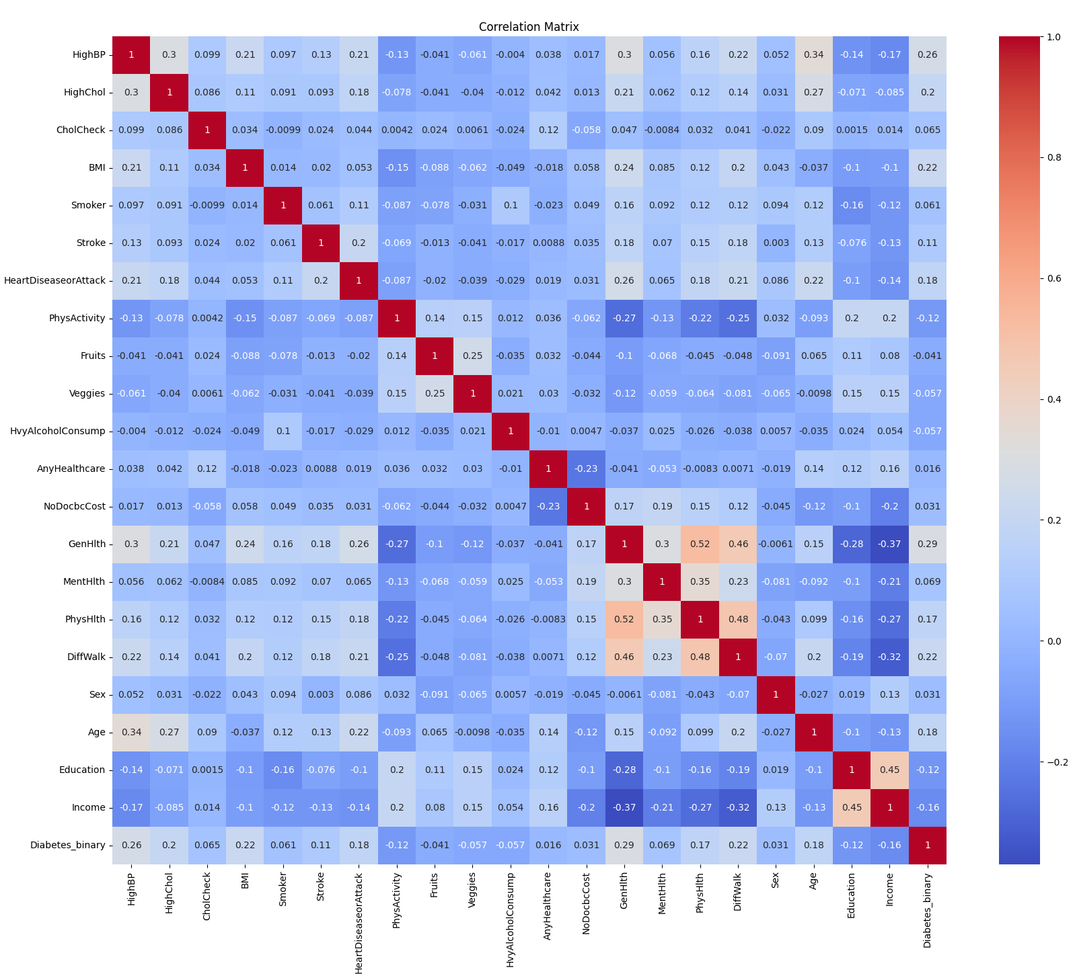
Correlation Matrix
Slight Correlation for General Health
Physical Health
Difficulty Walking
Largely Uncorrelated features

Slide 5
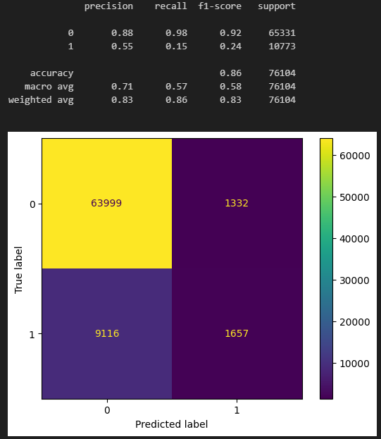
Logistic Regression
6.2 Seconds to train and test
Best at TN, Worst at TP, Most FN

Slide 6
SVM Classifier
Failed to hyper-parameterize and Cross validate.
(rbf) x (poly) x (cv) x (# of rows)
16 x 32 x 10 x 253,680 = 1,298,841,600 ~ 1.3B total rows to process

Slide 7
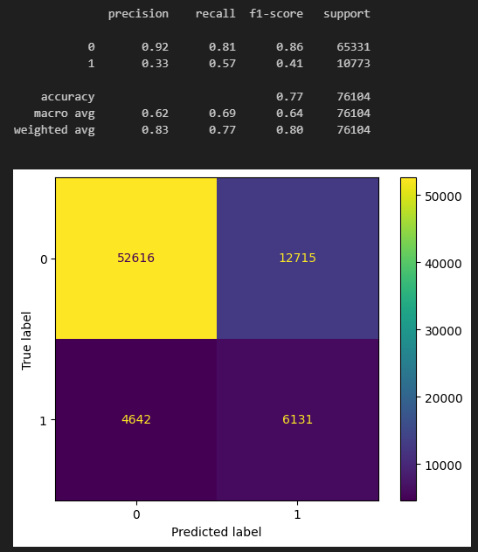
Naïve Bayes
1.1 Seconds to train and test
Didn’t excel in any ONE area.
Second highest TP & FP
Second lowest TN & FN

Slide 8
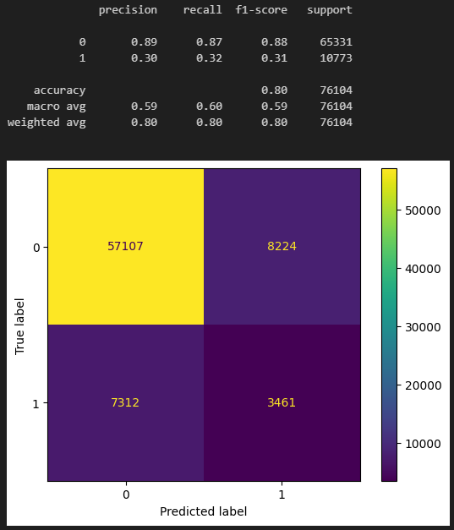
Decision Tree
8.3 Seconds to train and test

Slide 9
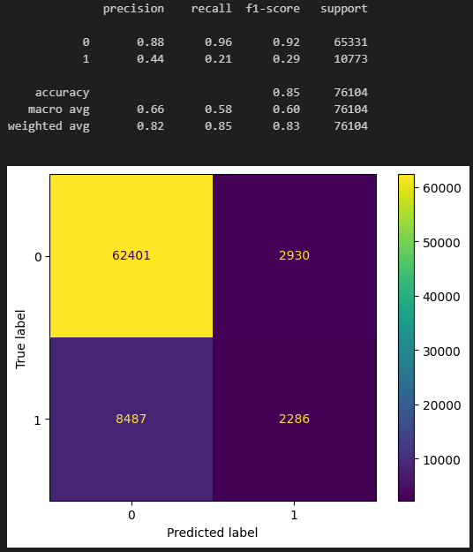
Ensemble Random Forest
19.1 Seconds to train and test
Worse than Adaboost and LR

Slide 10
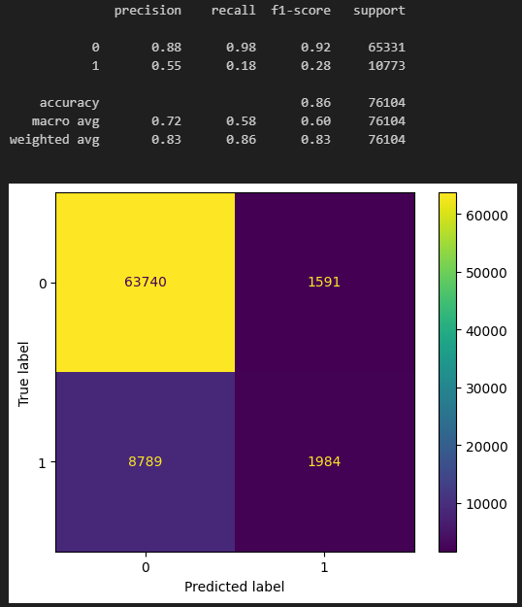
Adaboost
1 Min & 49.3 Sec to train and test
Similar to Logistic Regression’s performance

Slide 11
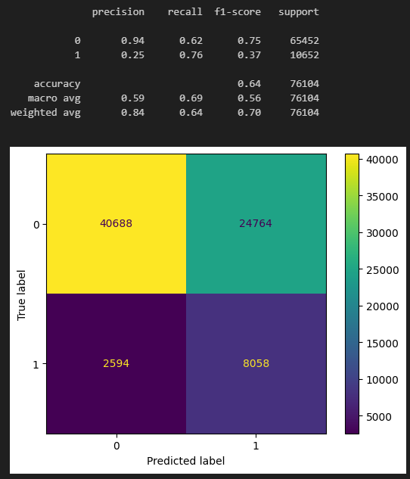
Learning Vector Quantization LVQ
6 Min & 48.0 Sec to train and test
Performed best for TP
Significantly more FP
Issues:
No updated library
Limitations on other’s implementations
6+ different LVQ models with slight differences
Under-fitting issue related to alpha.

Slide 12
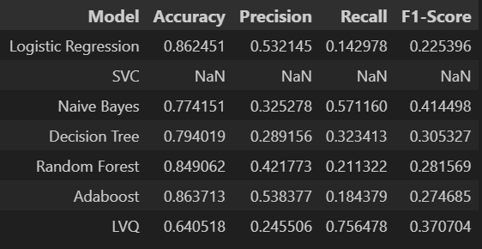
Tabulated Results
Naïve Bayes preformed the best overall.
LVQ predicted most TP and least TN
Due to data being skewed towards 0 and other issues, most of the models struggle to properly classify True Positives

Slide 13
Reflection
Utilized SMOTE to improve class distribution.
False (Class 0) was over represented in the dataset
Would like to hyper-param SVM on a subset of the data.
Unprepared for LVQ.
Current libraries didn’t work and several implementations had limitations
Project burned me out.

